Slide 1

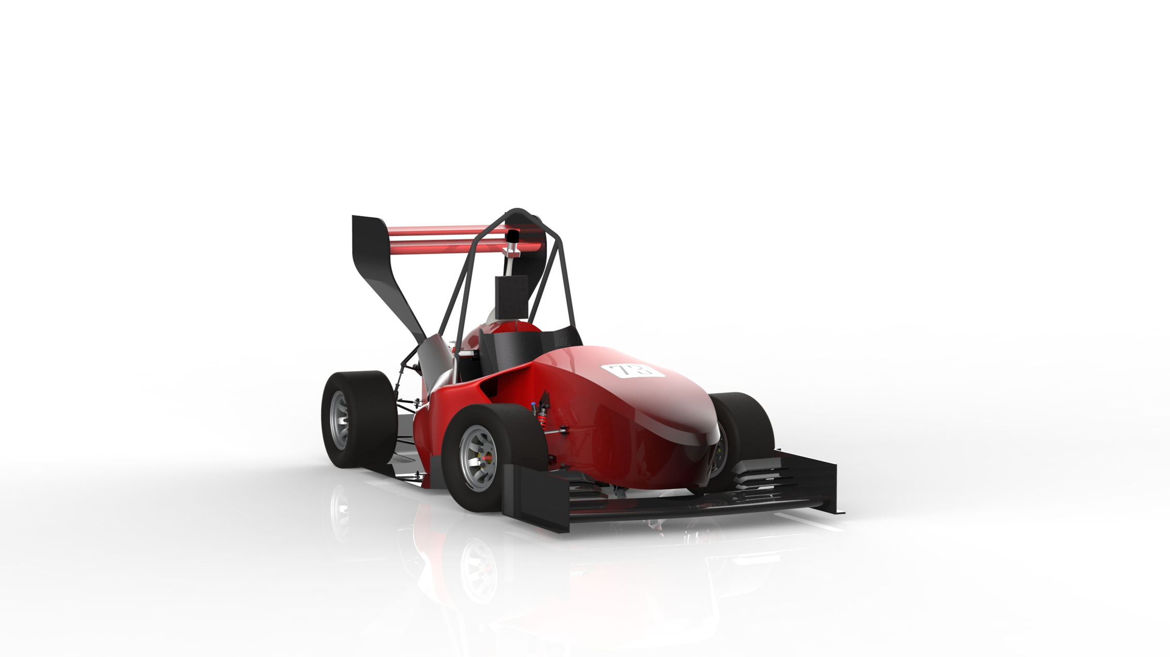
Low Voltage

Slide 2
Wheel Speed module

Slide 3
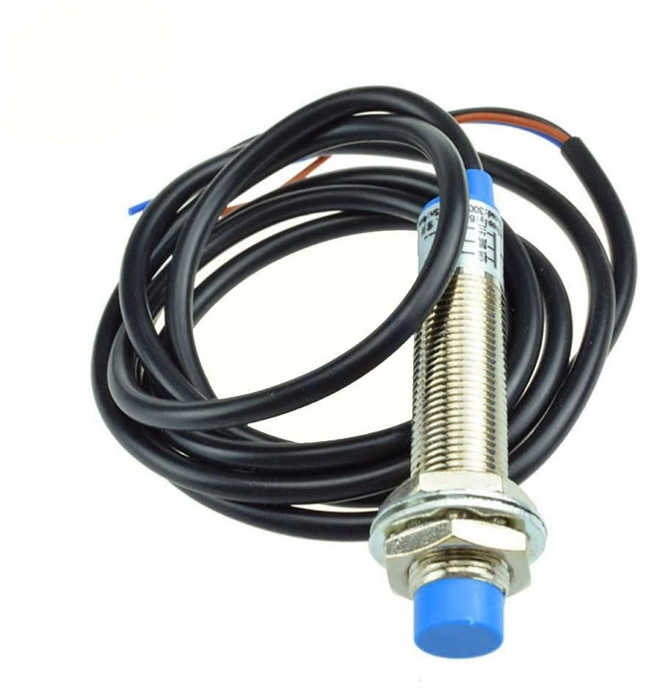
Used Sensor
Inductive proximity sensor.
Options available:
1. 15mm Detection Distance
2. 8mm Detection Distance
3. 4mm Detection Distance
4. 2mm Detection Distance
*We go for shorter distance detections

Slide 4
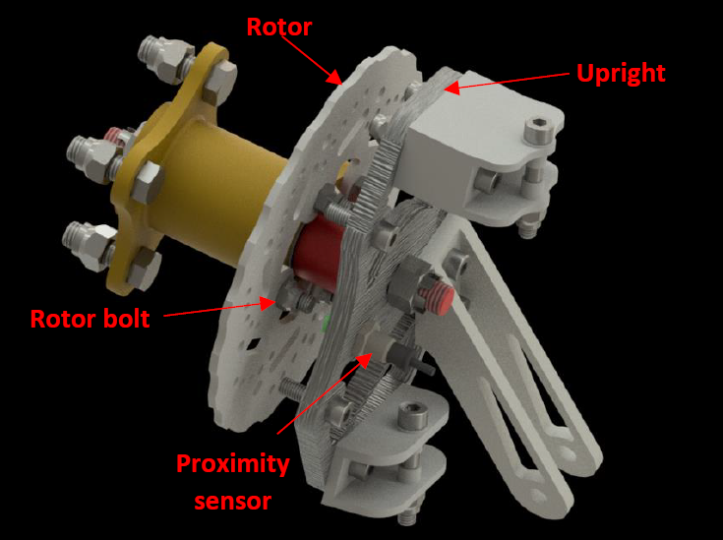
Sensor fixation

Slide 5
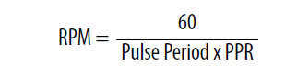
How does the system work?
There are four of rotary blots, when the sensor detects a rising edge, so it detected one of the blots.
By measuring the time between the detections of the blots so we can measure wheel’s RPM and Speed.
For this purpose, We use a hardware timer in input capture mode(ICU).

Slide 6
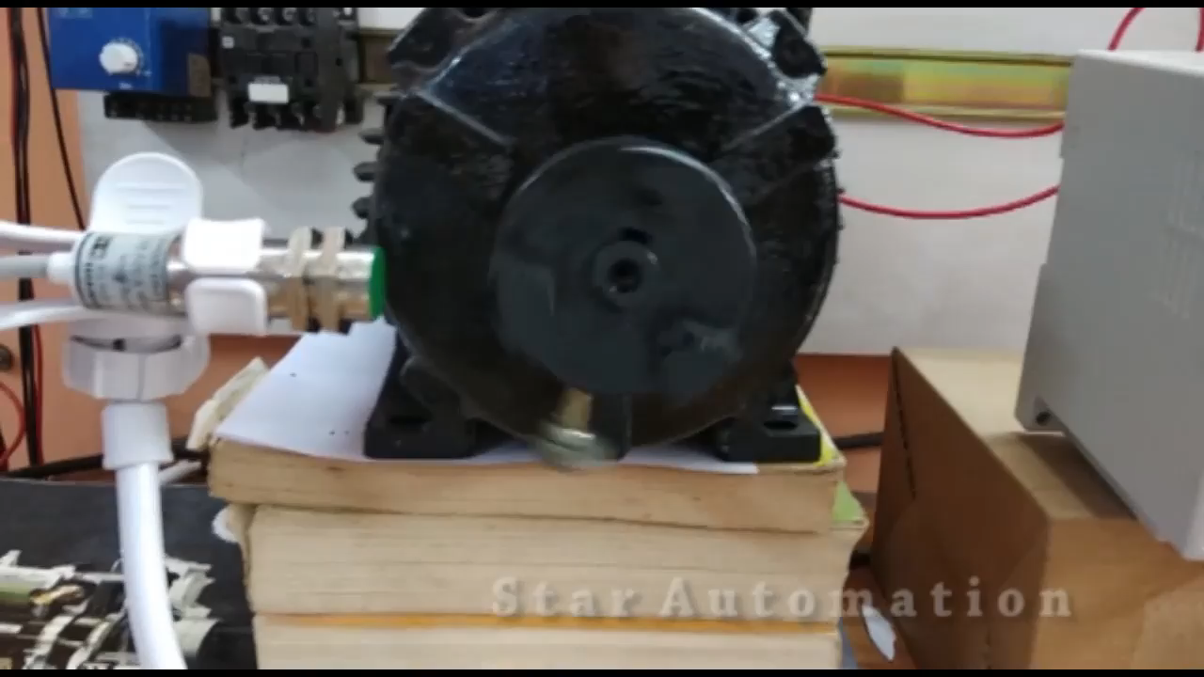

Slide 7
Conflicts
The optimum way to calculate wheel’s RPM?
Do the rear wheels’ measurements matter?

Slide 8
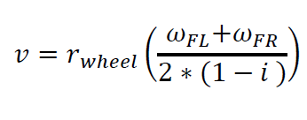
Do the rear wheels’ measurements matter?
In our regular car’s speed calculations, we depend on the two front wheels as they have the same speed as the body of the car, So we use this formula:
In this case we don’t include
The two rear wheels in car’s speed Calculation, due to wheel’s slipping.
So, we can exclude the two rear inductive proximity.
sensors and that reduces some overhead on the CPU.
we consider wheel’s slip ratio(i)- when the break switch is pressed-as its average value(0.1→0.2).

Slide 9
Why we may need it?
By considering this we can get better average reading while breaking.
By considering this we can get better average reading while breaking.

Slide 10
The optimum way to calculate wheel’s RPM?
One Detection
1.The sensor detects one blot.
2.Calculate the time to detect that blot.
3.Calculate the RPM.
4.Divide RPM value by PPR(4).
Multilabel Detections
1.The sensor detects the 4 blots.
2. Calculate the time to detect each blot.
2.Store the time for the 4 detections into a buffer.
3.Calculate RPM due to sum of the four detections(1REV)
Why not to use: If the blots are not exactly spaced that
causes RPM indication to be erratic.
Why not to use: there will be a very slightly delay due to getting the RPM value every 1 complete Revolution.
Why to use: the highest RPM Refresh rate you can get
Why to use: You can get more accurate readings.

Slide 11
CAN Message Organization
If the rear wheel’s RPM does matter
CAN Message’s payload will consist of 8 bytes:
2 bytes (Front Left RPM)
2 bytes (Front Right RPM)
2 Bytes (Speed)
2 Bytes (Time Stamp)
If the rear wheel’s RPM doesn’t matter
CAN Message’s payload will consist of 8 bytes:
2 bytes (Front Left RPM)
2 bytes (Front Right RPM)
2 Bytes (Rear Left RPM)
2 Bytes (Rear Right RPM)
We Can Send the speed over CAN bus at it is integer value, the Fraction part may not be critical.

Slide 12
Code enhancement
Timer resolution is constant and can be calculated outside the ISR
Avoid registers direct accessing .

Slide 13
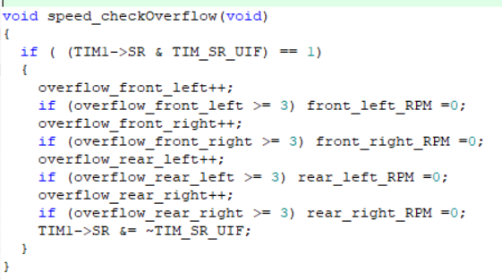
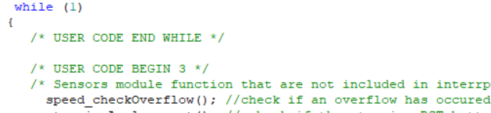
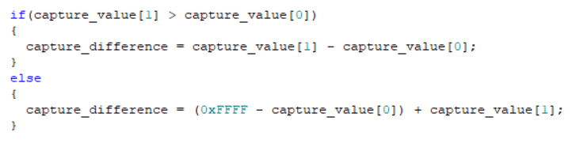
Better timer overflow handling
Instead of implementing a sperate function that is running in the super loop, and doing multiplication
It can be handled in more simple way
using if condition.

Slide 14
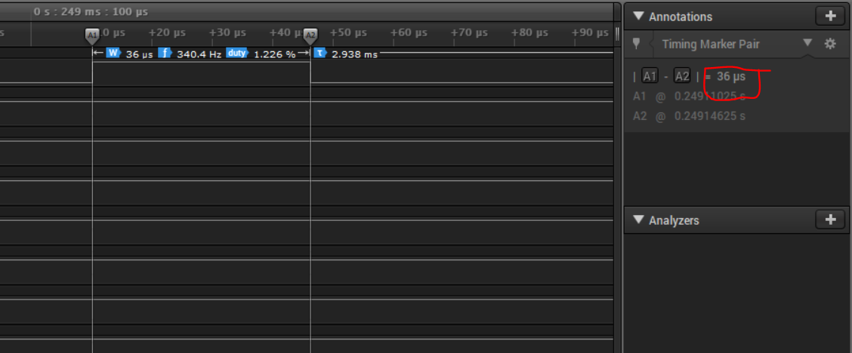
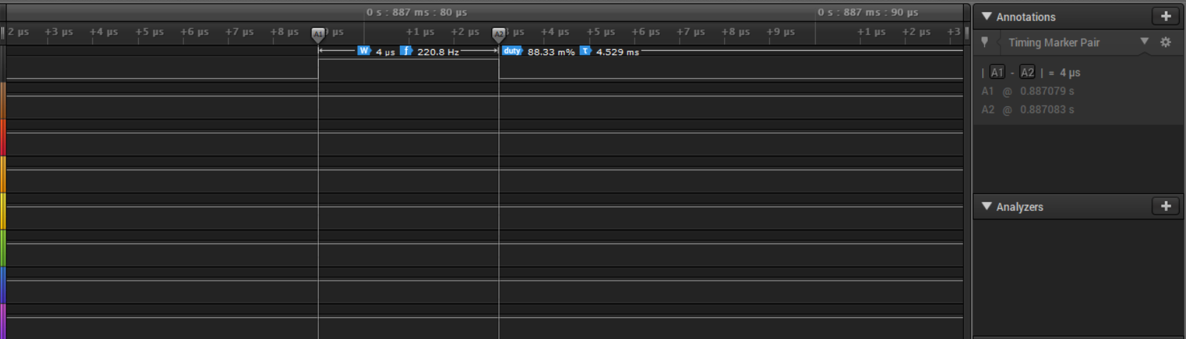
Less time serving the ISR
ISR does all calculations
ISR just store ICU Values And the main code does all calculations
We'll save nine times the time

Slide 15
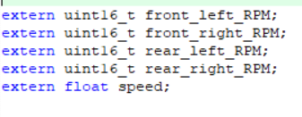
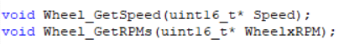
Design enhancement
Implement getter functions instead of using extern keyword:

Slide 16
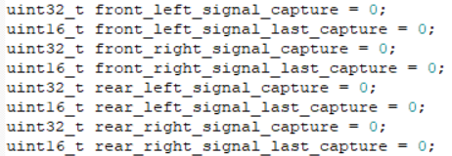
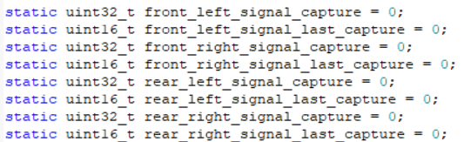
Use static keyword in file scope variables:

Slide 17
Data Acquisition

Slide 18
Old integration issues

Slide 19
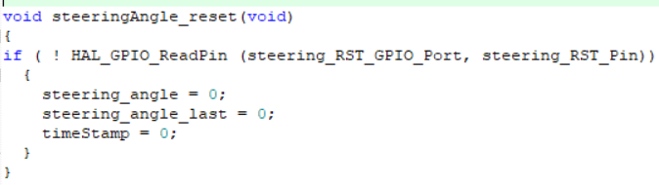
External Interrupt
Causes: Saving CPU Cycles in the super loop checking if switch it is pressed or not

Slide 20
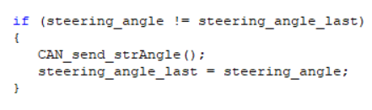
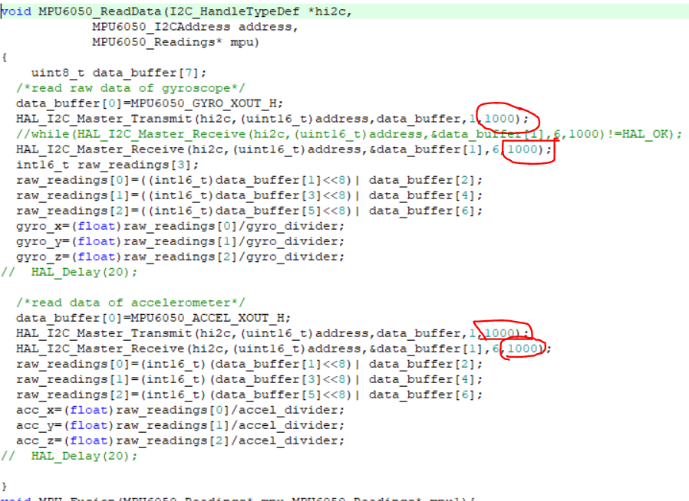
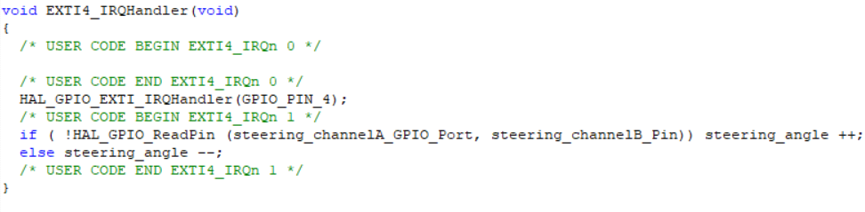
Events Delay

Slide 21
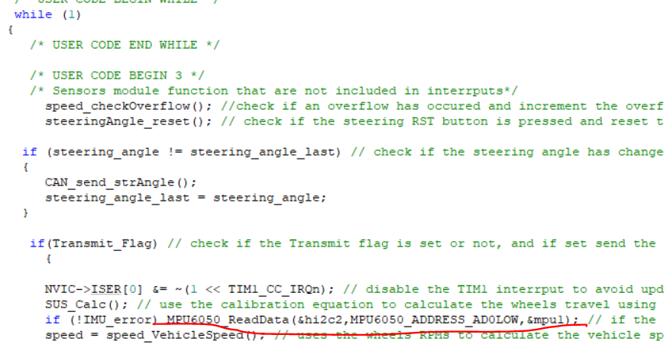
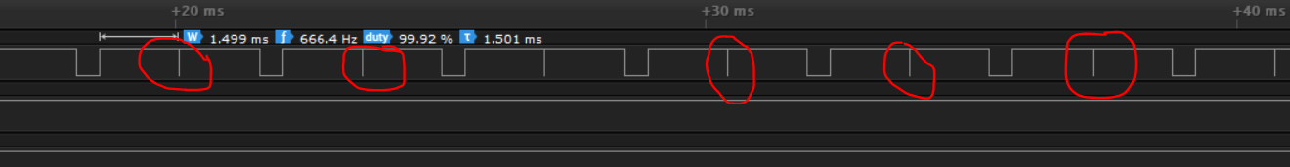
Random sample timing
Example
MPU Read functions in super loop

Slide 22
Priority
In this design there is no place for Priority functions

Slide 23
Solution

Slide 24
Real Time Operating System (RTOS)

Slide 25
Why using RTOS?

Slide 26
Solving delays
Avoiding Events delay, data overrun.
getting the data whenever the value changed if you want.

Slide 27
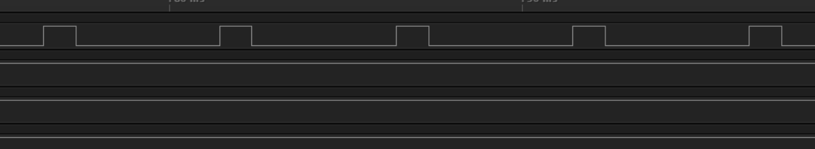
Solving random timing issues

Slide 28
Critical tasks always first
Higher priority tasks(steering angle) can preempt any task and do its work.
No need for the task to wait until its other functions finishes its work.

Slide 29
Saving some CPU Cycles
Tasks that need data from other tasks(dependent Tasks) won’t halt the CPU, it will be blocked giving some space for other tasks to run.

Slide 30
Thank you

